Slide 1




Master Pages
Using ASP.NET Master Pages
Svetlin Nakov
Technical Trainer
http://nakov.com
Telerik Software Academy
academy.telerik.com

Slide 2

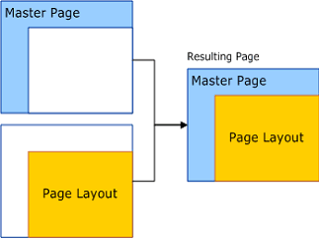

Table of Contents
Master Pages and Content Pages
Nested Master Pages

Slide 3

Master Pages and Content Pages
Notes:
*
29-08-201307/16/96
(c) 2005 National Academy for Software Development - http://academy.devbg.org. All rights reserved. Unauthorized copying or re-distribution is strictly prohibited.*
3##

Slide 4
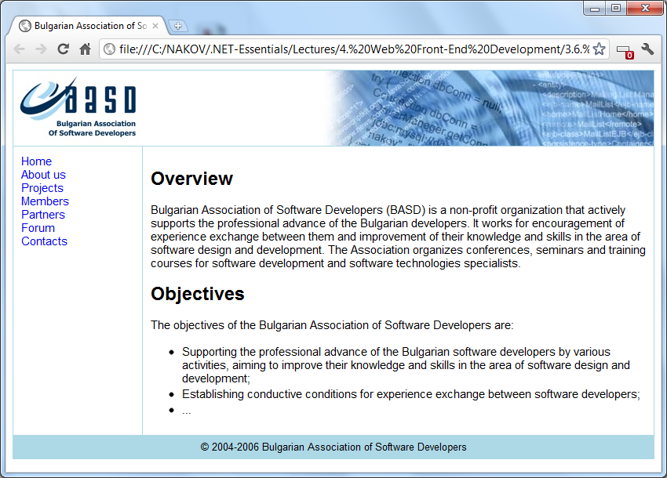
Master and Content Pages
Assume we have a classical web site like this:

Slide 5
The Master Page – Sections
The header is shared between all pages:
Header

Slide 6
The Master Page – Sections (2)
The navigation is shared between all pages:
Navigation

Slide 7
The Master Page – Sections (3)
The footer is also shared between all pages:
Footer

Slide 8
The Content Pages
The content is different for all pages:
Content

Slide 9
Why Use Master and Content Pages?
Master pages provide reusable UI templates
The structure of the site is repeated over most of its pages
ASP.NET master pages allow to share the common HTML between few pages
Common Look & Feel
To avoid the repeating (and copying) of HTML code and the logic behind it

Slide 10
ASP.NET Master Pages
Master pages in ASP.NET Web Forms start with the @Master directive
Mostly the same attributes as the @Page directive
Master pages can contain:
Markup for the page (<html>, <body>, …)
Standard contents (HTML, ASP.NET controls)
<asp:ContentPlaceHolder> controls which can be replaced in the content pages

Slide 11
Content Pages
Content pages derive the entire content and logic from their master page
Use the @Page directive with MasterPageFile attribute pointing to the master page
Replace a <asp:ContentPlaceHolder> from the master page by using the <asp:Content> control
Set the ContentPlaceHolderID property
Points to the ContentPlaceHolder from the Master page which content we want to replace

Slide 12
Master and Content Pages – Mechanics
Site.master
Default.aspx (content page)
<%@ Master %>
<%@ Page MasterPageFile=
"~/Site.master" %>
Header
Navigation
<asp:Content
ContentPlaceHolderID
"MainContent">
Here we put the contents
with which we want to
replace the default ones
</asp:content>
<asp:ContentPlaceHolder
ID="MainContent">
Here we put the
default content
</asp:ContentPlaceHolder>
Footer

Slide 13


Using Master Pages
Live Demo

Slide 14
Master and Content Pages – Advanced
We can change the Master page at runtime in the code-behind
We can also select the Master page according to the browser type
Page.MasterPageFile = "~/SiteLayout.master";
<%@ Page Language="C#"
ie:MasterPageFile="~/IESiteLayout.master"
mozilla:MasterPageFile="~/FFSiteLayout.master" %>

Slide 15
Nested Master Pages
Master pages can be nested, with one master page referencing another as its master
Nested master pages allow creating componentized master pages
A child master page has the file name extension .master, as any master page
<% @ Master Language="C#" %> // Parent Master Page
<asp:ContentPlaceHolder ID="MainContent" runat="server" />
<%@ Master Language="C#" MasterPageFile="~/Parent.master"%>
<asp:Content ID="Menu" ContentPlaceholderID="MainContent"
runat="server">
<asp:ContentPlaceHolder ID="LeftMenu" runat="server" />
<asp:ContentPlaceHolder ID="TopMenu" runat="server" />
</asp:Content> // Child Master Page

Slide 16
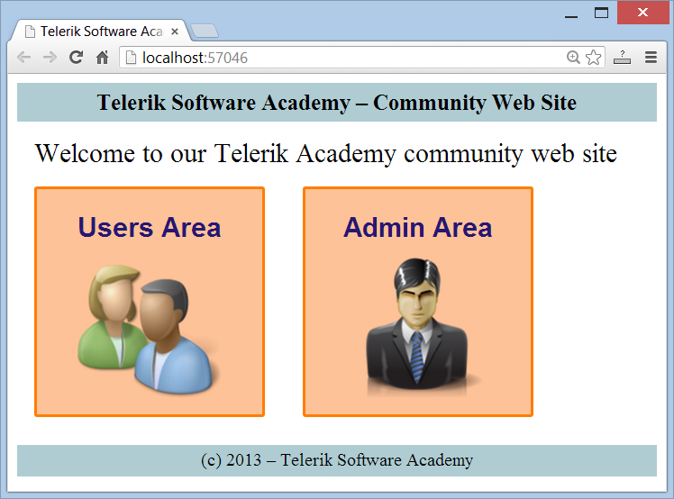
Nested Master Pages
Live Demo

Slide 17

Master Pages
?
?
?
?
?
?
?
?
?
http://academy.telerik.com

Slide 18
Exercises
Implement a simple Web Forms application using master pages. The application should be like a user profile – separate pages for Personal Info, Friends, Additional Info, etc. + Sidebar for navigation.
Implement a Web Forms application using nested master pages. It should be a Web site of international company. You should have master layout page and few different nested master pages for each country and few content pages in different language, for each country. Define "Home", "About" and "Contacts" pages for each country using its master page.

Slide 19



Free Trainings @ Telerik Academy
"Web Design with HTML 5, CSS 3 and JavaScript" course @ Telerik Academy
html5course.telerik.com
Telerik Software Academy
academy.telerik.com
Telerik Academy @ Facebook
facebook.com/TelerikAcademy
Telerik Software Academy Forums
forums.academy.telerik.com

